Slide 1
 | Data Structures and Algorithms

Slide 2
Elementary DS -Stack, Queue, Lists
Session 2

Slide 3
Agenda
Stacks
Stack representation
Applications
Queues
Conventional Queue
Circular Queue
Priority Queue
Applications
Lists
SLL, CSLL, DLL

Slide 4
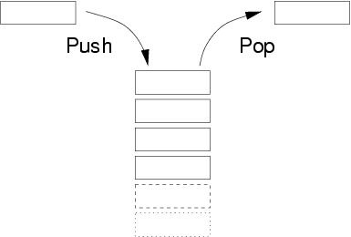
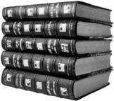
Stack
A stack is defined as a linear list in which insertions and deletions take place at the same end based on the Last-In-First-Out (LIFO) concept.
This end is called as the top of the stack and the other end is called as the bottom of the stack.
Stack Operations – Normal Case
Push operation in which a data item is placed at the location pointed to by the stack pointer.
Pop operation a data item at the current location pointed to by the stack pointer is removed.

Slide 5
ADT
An abstract data type (ADT) is an abstraction of a data structure.
An ADT specifies: 
Data stored
Operations on the data
Error conditions associated with operations

Slide 6
ADT of Stack

Slide 7
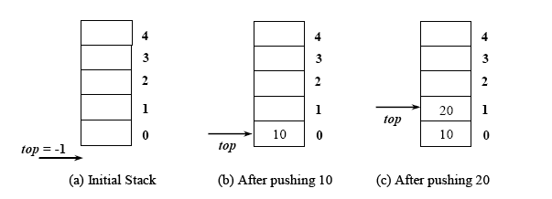
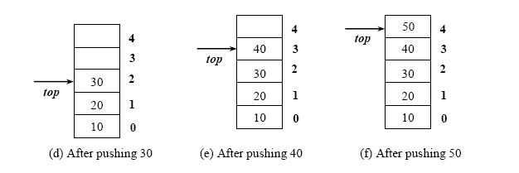
Stack Push Operation

Slide 8
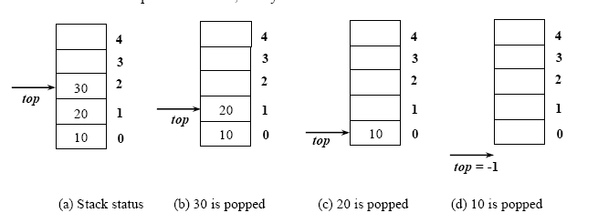
Stack Pop Operation

Slide 9
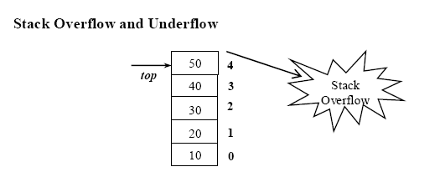
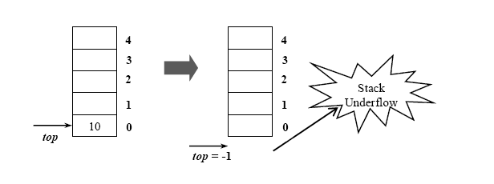
Stack Exceptions

Slide 10
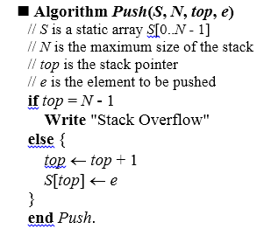
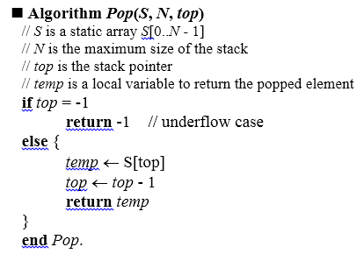
Algorithms

Slide 11
Alternate Design
void * Pop(int items[], int *top)
{
void *temp; // generic pointer
char c = 'U';
if(*top == -1)
{
temp = &c;
return temp; /* underflow */
}
temp = &items[*top];
(*top)--;
return temp;
}

Slide 12
main()
void *pe;
…………………………………
pe = Pop(items, &top);
if(*(char *)pe == 'U')
printf("Stack underflow\n");
else
printf("Popped element: %d\n", *(int *)pe);
break;

Slide 13
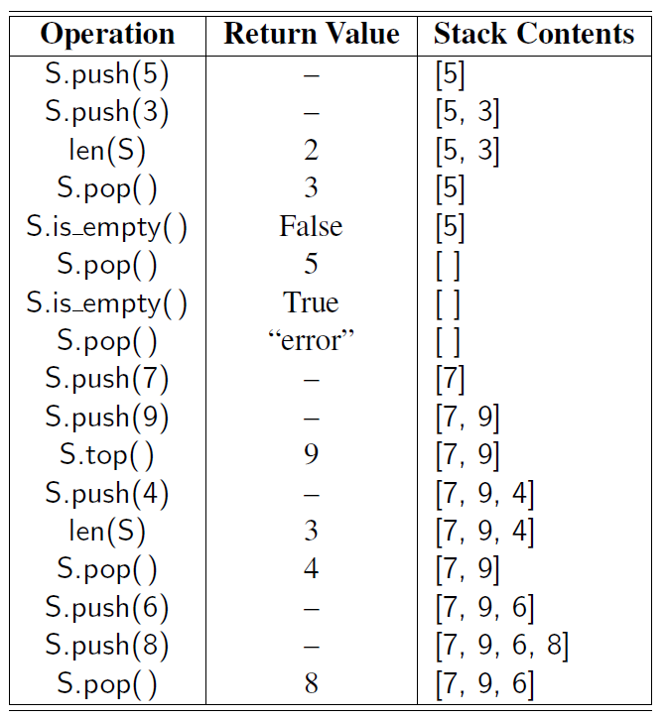
Series of Stack Operations

Slide 14
Applications of Stack
Notation
Infix Notation
Example-1:
A + B
2 + 3
(3 + 4) * 7
Infix
2 + 3
Prefix
+ 2 3
Postfix
2 3 +
operand1
operator
operand2

Slide 15
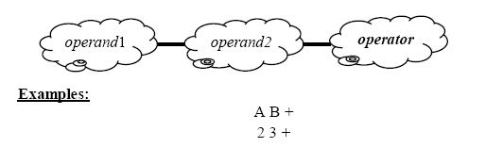
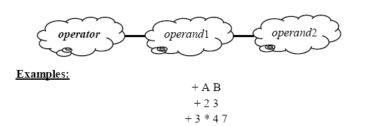
Notations
Postfix Notation
Prefix Notation

Slide 16
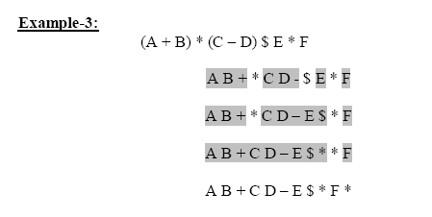
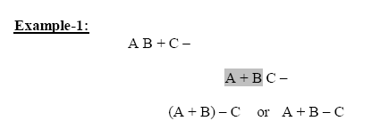
Conversions
Infix to Postfix
Postfix to infix

Slide 17
Evaluation of Postfix Expressions
■ Algorithm Postfix(expr[0..N])
// expr[0..N] expression array - char
// N is the length of the expression array
// S is the stack array
// pos to scan the symbols
top ← -1
pos = 0
while pos ≠ N do
c ← expr[pos]
if c =  //  = {0, 1, 2, .., 9}
Push(S, top, c)
else
if c = ⊕ // ⊕ = { +, -, ..}
op1 ← Pop(S, top)
op2 ← Pop(S, top)
r ← op1 ⊕ op2
Push(S, top, r)
pos ← pos + 1
result ← Pop(S, top) // final result is in stack
end Postfix.

Slide 18
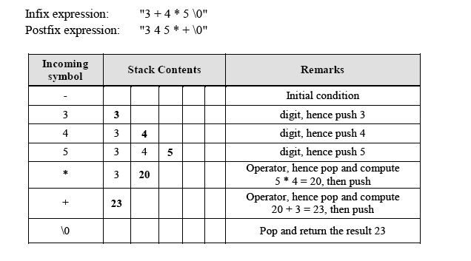
Example

Slide 19
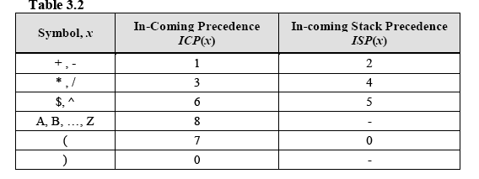
Infix-to-Postfix Conversion

Slide 20
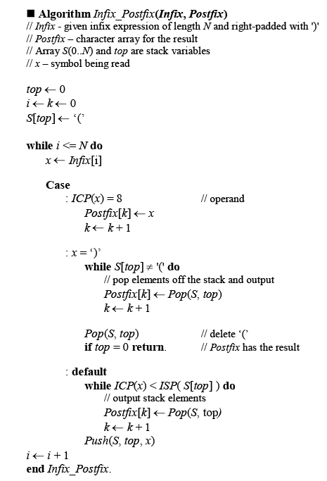

Slide 21
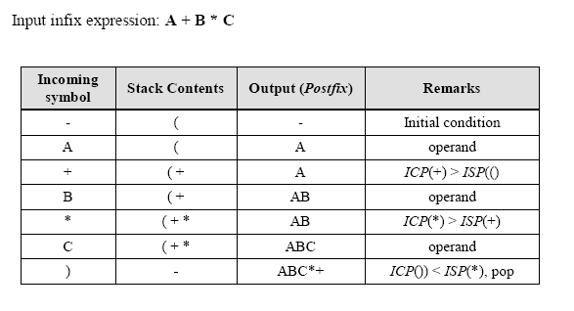
Example-1

Slide 22
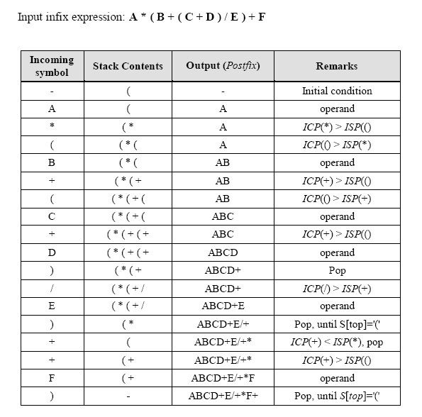
Example-2

Slide 23
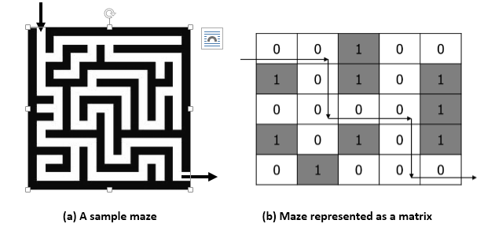
Example-3: Maze

Slide 24
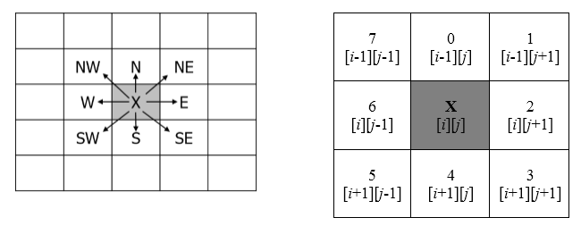
Maze Solution

Slide 25
Queues
A queue is a linear list in which additions and deletions take place at two different ends.
The end at which insertions take place is called the rear, and at which deletions happen is called the front.
The most well known operation of the queue is the First-In-First-Out (FIFO) queue process.
In a FIFO queue, the first element in the queue will be the first one out.
Ordinary queues
Circular queues
Priority queues
Delete from Queue
Enter into Queue

Slide 26

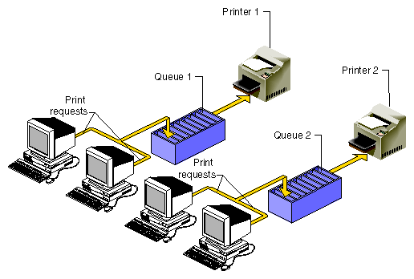

Examples
There are a number of real world examples that can be given for queues
For instance
people standing in front of a cinema hall counter, voting booths, milk booths, billing counters, etc
objects moving in assembly units, bottling industry, etc

Slide 27
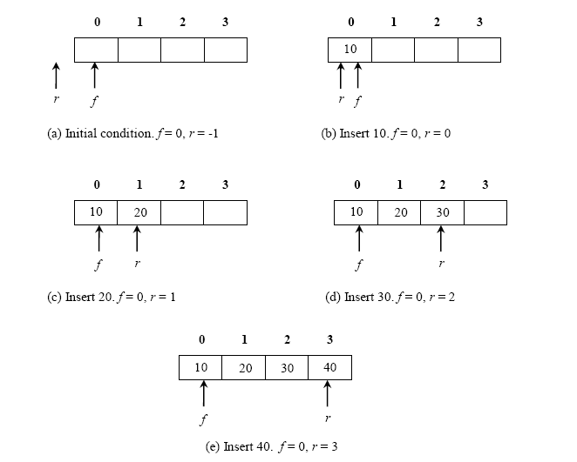
enqueue Operation

Slide 28
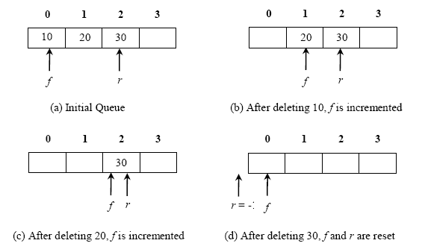
dequeue Operation

Slide 29
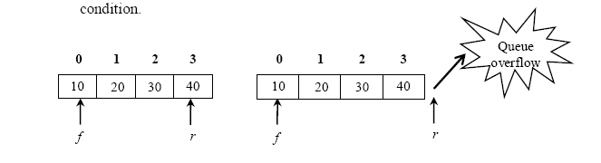
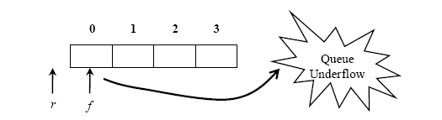
Exception Cases
Queue Overflow
Queue Overflow
Queue Underflow

Slide 30
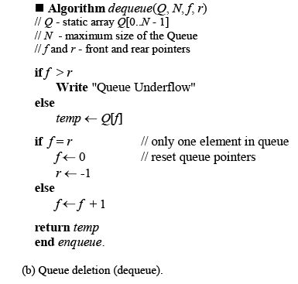
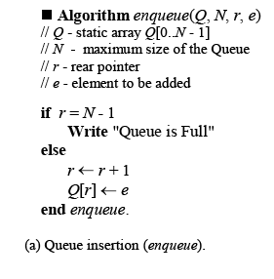
Algorithms for enqueue and dequeue

Slide 31
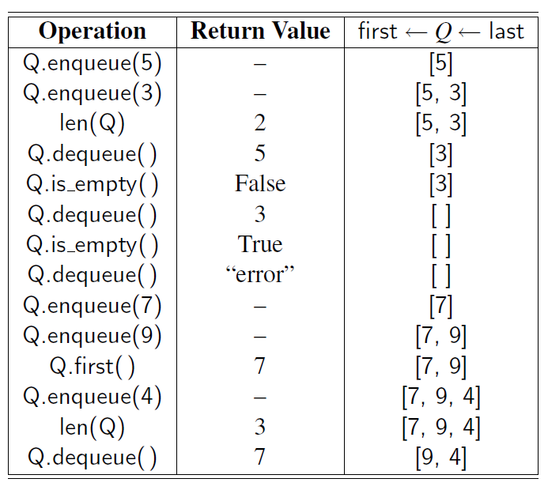
Series of Queue Operations

Slide 32
Exercise 1
Write an algorithm to implement a Stack using two Queues.
public static void push(String element) {
if (q1.size() == 0)
q1.add(element);
else {
while (q1.size() != 0)
q2.add(q1.remove());
q1.add(element);
while (q2.size() != 0)
q1.add(q2.remove());
}
}
public static String pop() {
return q1.remove();
}

Slide 33
Exercise 2
Write an algorithm to implement a Queue using two Stacks.
public static void enqueue (String element) {
stack1.push(element);
}
public static String dequeue() {
if (stack2.size() == 0) {
if (stack1.size() == 0) {
return ("Cannot dequeue because queue is empty");
}
while (stack1.size() > 0) {
var p = stack1.pop();
stack2.push(p);
}
}
return stack2.pop();
}

Slide 34
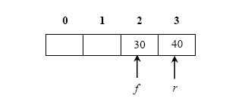
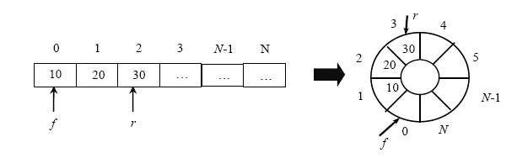
CIRCULAR QUEUES
What is the problem with ordinary queues?
When rear pointer reaches MAX – 1, irrespective of the front pointer, the queue status is full. Why?
Because, we simply check r = N-1, display the error message, irrespective of the front pointer.

Slide 35
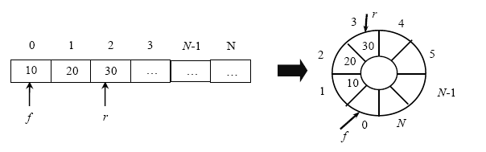
Circular Queue Operations
enCqueue - Add an element to the circular queue
deCqueue – Delete an element from the circular queue
Initialization
f = 0 and r = 0
Circular Queue Insertion
An element e is added into the circular queue using the formula,
r = (r + 1) mod N
General structure of a Circular Queue

Slide 36
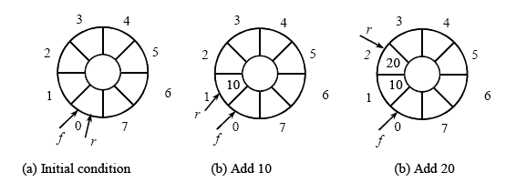
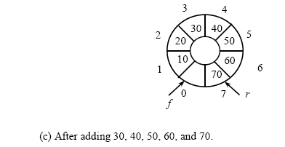
Cqueue Insertion

Slide 37

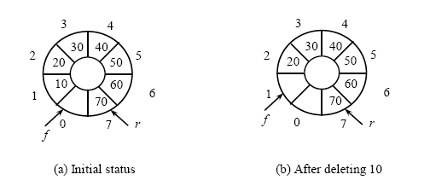
Cqueue deletion

Slide 38
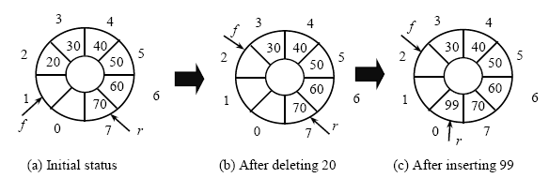
Advantages of Circular Queue
The real advantage of circular queue over the ordinary queue is when r = N-1 and f is pointing to locations greater than 0.
Exception Cases
Overflow Condition: f = (r + 1) mod N
Underflow Condition: f = r

Slide 39
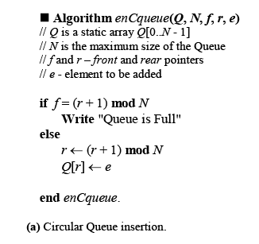
Algorithms for Cqueue
■ Algorithm deCqueue(Q, N, f, r)
// Q is a static array Q[0..N - 1]
// N is the maximum size of the Queue
// f and r - front and rear pointers
// returns deleted element
if f = r
Write "Queue Underflow"
else
f ← (f + 1) mod N
return Q[f]
end enCqueue.
(b) Circular Queue deletion.

Slide 40
PRIORITY QUEUES
An ordinary queue works on FIFO policy, but the order of deletion in a priority queue depends upon the priority value assigned to the element.
Normally elements are deleted either in increasing or decreasing order of priority rather than in the order in which they arrive.
For example, an element with the highest priority may have to be deleted first irrespective of where it is stored in the queue.
Delete highest priority
Insert with priorities

Slide 41
Applications of Priority Queues
Auctions and stock market
In simulations of airports, parking lots, priority queues can be used to maintain who goes next.
In greedy algorithms, priority queues may be used to pull largest item.
Priority queuing can be used to manage bandwidth in a shared network traffic in a router.
Another use of a priority queue is to manage the events in a discrete event simulation.
Ascending priority queue (Min priority queue) - element with minimum priority or value is deleted first.
Descending priority queue (Max priority queue) - element with maximum priority or value is deleted first.

Slide 42
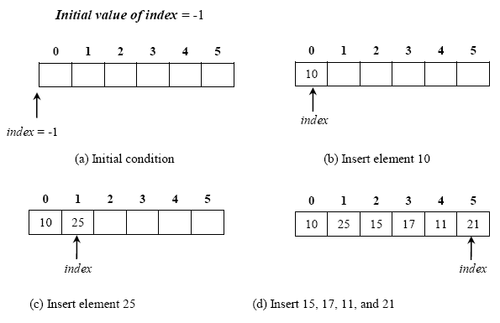
Priority Queue Operations
enPqueue: enter an element, x into the queue irrespective of its priority.
dePqueue: delete an element from the queue whose priority is the highest.
Priority Queue Insertion – enPqueue:
insertion is same as the traditional queue.
But we shall not use two pointers front and rear, but manage with only one pointer, index.

Slide 43
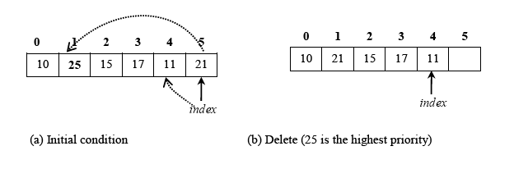
PQ-Deletion
First find the largest element and save it in a temporary variable, k.
Copy the last element to occupy the position of the largest element.
In our example, the largest element 25 is at position 1. That 25 and 21 are swapped.
Then decrement the index by one (it points to element 11)
Return the largest element i.e. the element with the highest priority.

Slide 44
Algorithms for Priority Queue
Algorithm enPqueue(Q, N,
index, e)
if index = N - 1
Write "Priority Queue Full"
else
index ← index + 1
Q[index] ← e
end enPqueue.
Algorithm dePqueue(Q, N, index)
if index = -1
Write "Priority Queue Underflow"
return -1
k ← 0
for i ← 1 to index do
if Q[i] > Q[k]
k ← i //save the current max
temp ← Q[k]
Q[k] ← Q[index]
index ← index – 1
return temp
end enPqueue.

Slide 45
Lists

Slide 46
Agenda
Singly Linked List
Linked List as Stack
Linked List as Queue
Ordered Linked List
Circular Linked List
Circular List as a Stack
Circular List as a Queue
Doubly Linked List

Slide 47
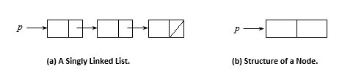

Singly Linked List
A singly linked list is one which consists of a sequence of nodes
Each node comprises of one or more data field(s) and one link per node, called next.

Slide 48
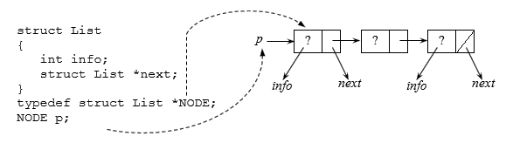
Self-referential Structure

Slide 49
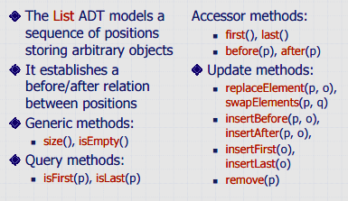
ADT

Slide 50
Applications
Linked lists are used to model many other data structures, such as stacks, queues, and their variations.
Sometimes, linked lists are used to implement associative arrays.
To manage the dynamic memory allocation, compilers use linked lists.
Hash tables use linked lists for collision resolution.
Linked may be a better data structure to represent the polynomials.

Slide 51


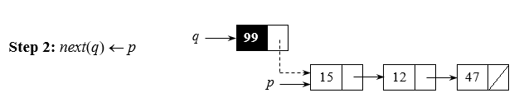
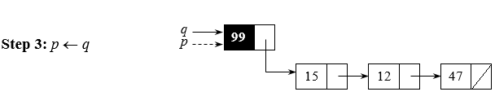
Insert Front

Slide 52
Algorithm
■ Algorithm InsertFirst(p, e)
// p - pointer to a linked list
// e - element to be added
// Getnode() returns a new node
q ← Getnode()
info(q) ← e
next(q) ← p
p ← q
return p
end InsertFirst.

Slide 53
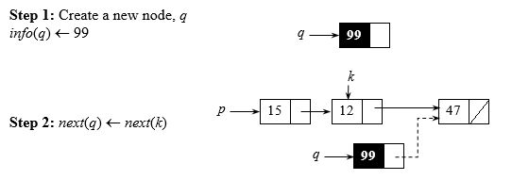
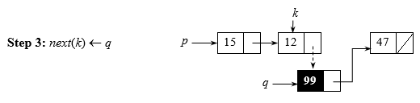
Insert in the Middle (key=12)

Slide 54
Algorithm
■ Algorithm InsertAfter(p, x, e)
k ← p
while k ≠ NIL and info(k) ≠ x do // find the key node’s address
k ← next(k)
if k = NIL {
Write "Node not found"
return p
}
q ← Getnode()
info(q) ← e
next(q) ← next(k)
next(k) ← q
return p
end InsertAfter.

Slide 55
Insert at the End
NODE InsertLast(NODE p, int e)
{
NODE q, k;
k = p;
if (p == NULL)
return p;
MALLOC(q, sizeof(struct List), NODE);
q->info = e;
q->next = NULL;
while (k->next != NULL) /* find address of k */
k = k->next;
k->next = q;
return p;
}

Slide 56
Delete Operation
■ Algorithm DeleteFirstNode(p)
// p - pointer to linked list
// returns either NIL or address of p
if p = NIL
Write "Node not found"
else
p ← next(p)
return p
end DeleteFirstNode.

Slide 57
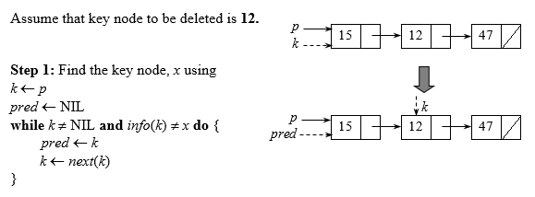
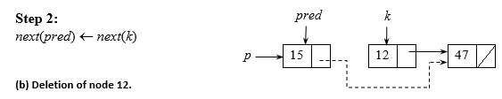
Delete Middle Node

Slide 58
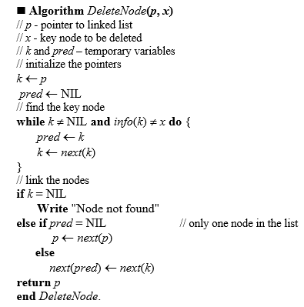

Slide 59
Searching
int SearchNode(NODE p, int x)
{
NODE k = p;
while (k != NULL && k->info != x)
k = k->next;
if (k == NULL) return 0;
else return 1;
}

Slide 60

DOUBLY LINKED LIST
Doubly Linked List (DLL) is similar to singly linked list, except that each node has two pointers
One to the next node, and one to the previous node.
This makes life nice in many ways:
You can traverse lists forward and backward.
You can insert anywhere in a list easily. This includes inserting before a node, after a node, at the front of the list, and at the end of the list.
You can delete nodes very easily, without using additional pointers.

Slide 61
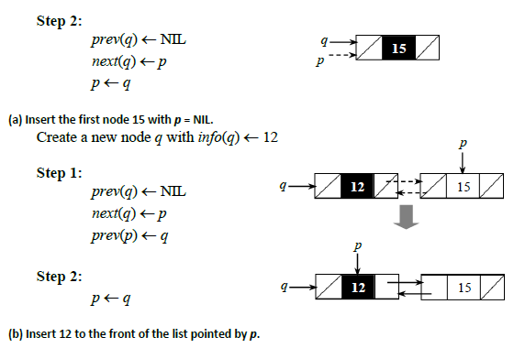
Create DLL
Step 1: Create a new node q with info(q) <- 15

Slide 62
Algorithm
■ Algorithm InsertFront(p, e)
// p – list pointer
// e - element to be inserted
q ← Getnode()
info(q) ← e
prev(q) ← NIL
next(q) ← p
if p ≠ NIL // not the first node
prev(p) ← q
p ← q
return p
end InsertFront.
p
q
15
90
p
q
15
90

Slide 63


Insert after k^{th} Node
2
1
4
3
1
2
3
prev(next(k)) ← q
4
next(k) ← q

Slide 64


Algorithm
prev(next(k)) ← q
next(k) ← q

Slide 65

Delete

Slide 66

Algorithm

Slide 67
Thank You
Thank You

